Slide 1
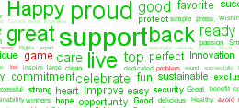
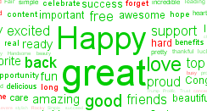
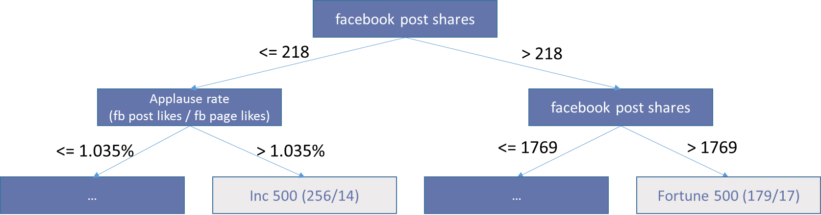
Do established companies use social media differently than fast-growing companies?
Aydan Alyanak, Derrick Eckardt, Michael Mzyk
Indiana University, School of Informatics and Computing, Data Science Program
INTRODUCTION
RESULTS
CONCLUSIONS
Our work is motivated by the research question as to whether there are significant similarities or differences in social media usage across different companies, and whether these patterns are predictable.
We focused on the most successful companies in the United States, belonging to the “Fortune 500” group of established businesses or to the “Inc 500” group of fast-growing businesses. We hypothesized that there were differences in their use of social media, due to cultural and historical differences and different levels of social media knowledge and expertise.
Our goal was to predict whether a company is a “Fortune 500” or “Inc 500” company based on its Facebook and Twitter behavior, by comparing predictive power of Facebook and Twitter performance indicators.
The Inc 500 makes much more use of emotionally stronger words (happy, great, excited, amazing, awesome) than the Fortune 500. While the Fortune 500 tag cloud does use “happy” and “great”, to a lesser extent, with the remaining words to be more conservative in nature (ex: support, proud, commitment, sustainable).
Further, trends in word counts hint at different collaboration models (Fort500: World, Employee, Inc500: Market, Service) and planning horizons (Fort500: Year, Inc500: Day)
Fortune 500 companies tend to have significantly larger user communities on both Facebook and Twitter. Almost all “absolute” counts defined at the company level such as “Number of Likes (or Followers)” can be used as reliable proxies for predicting “Fortune 500 or Inc. 500” with accuracies of around 80%, without any need to use sophisticated prediction models at all.
It is far more interesting to exclude these KPIs from analysis and see how the remaining KPIs can be used to predict “Fortune 500 or Inc. 500”. We implemented J48 decision trees and visualized the resulting set of rules as a tree. We obtained consistent results for Facebook and Twitter with accuracies of around 85% and excellent ROC curve values, showing that Inc 500 companies often have significantly higher values for Applause Rate, Amplification Rate, and Conversation Rate than the Fortune 500 (see following Screenshot for Facebook):
kNN Algorithm or Ensembles of Trees for prediction (after normalizing all features) does not significantly improve results while generating less interpretable results (“black box algorithms”).
62% utilized Facebook, 65% utilized Twitter, 56% used both, and 30% used neither. We only attempted to classify companies within the social platforms they utilized
Social media postings are yet another field where well-established companies (Fortune 500) are predictably conservative, and fast-growing companies (Inc 500) take more risks. This study provides evidence that there are significant, predictable differences on how different types of companies use social media.
We found that Inc 500 companies use words in their social media posting more regularly that are associated with emotional extremes. Inc 500 companies are rewarded for their risky behavior, with higher engagement rates with their followers, resulting in a much more interactive experience with their customers.
Fortune 500 companies do leverage their history and brand recognition in order to reach much broader audiences that Inc 500 companies can only dream about it.
In conclusion, if a posting conjures a strong emotion, it’s probably from an Inc 500 company. If a lot have people seen it, it likely originated from a Fortune 500 company.
Fortune 500
Inc 500
METHODS
We researched biographic information about these 1000 companies such as “Revenue” or “Number of employees,” and manually matched their industry categories using the Global Industry Classification Standard.
Next, we manually verified the Facebook and Twitter handles of each Fortune 500 and Inc 500 company, since automating this task with a scraper was unreliable due to each site’s unique web design. Utilizing Facebook and Twitter APIs, we pulled the most recent 125 postings from each company’s account together with counts of likes/followers (on company level and posting level), comments, and shares.
Then, we preprocessed and aggregated the raw data. We derived new ratio KPIs describing the relative engagement of the audience, such as Applause Rate, Amplification Rate and Conversation Rate. This resulted in a dataset with 1000 rows and 20 total features. Additionally, we prepared the dataset for simple Sentiment Analysis by tagging positive or negative words per posting according to the MPQA Corpus.
Lastly, descriptive statistics such as counts/averages and “Tag Clouds” were implemented. We built predictive models and tuned based on both simple classifiers (Decision Trees, kNN) and ensemble methods (DT Bagging, Random Forest). All results were evaluated in terms of accuracy, ROC and general interpretability of output.
FUTURE DIRECTIONS
We still would look to perform a cluster analysis of the companies grouped by their industry categories and biographic information. In addition, we performed the analysis in KNIME and Weka. We will document and package it so that it is repeatable for others in the future.
Other items we still hope to do, but will likely not get to:
We observed that some companies had invested in other social media platforms (LinkedIn, YouTube, Snapchat, blogging, etc) Inclusion of these could can potentially improve results.
We selected the most recent 125 postings in each social media platform. Some companies hit this within a day or two, and others took years. Using a time-based approach instead of a postings-based approach could improve results.
We anticipate doing cross-domain analysis of Facebook and Twitter, which could improve results.

